Slide 1


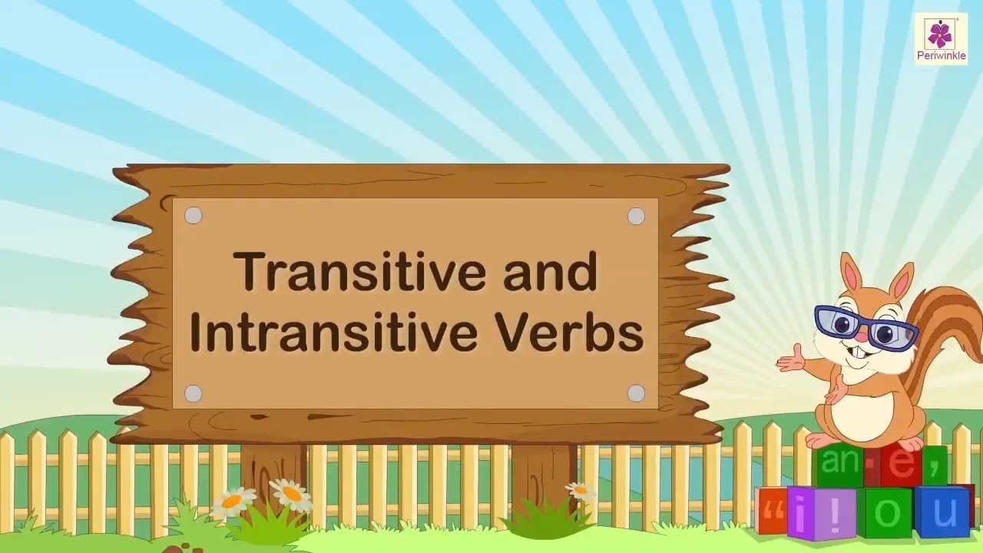


Slide 2
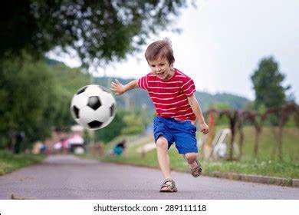
Rohan is playing with a ball

Slide 3
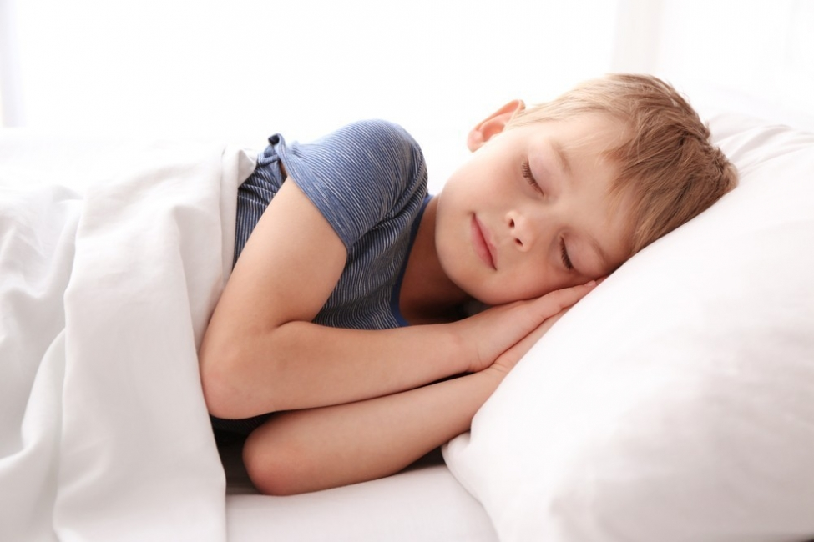
The boy is sleeping

Slide 4

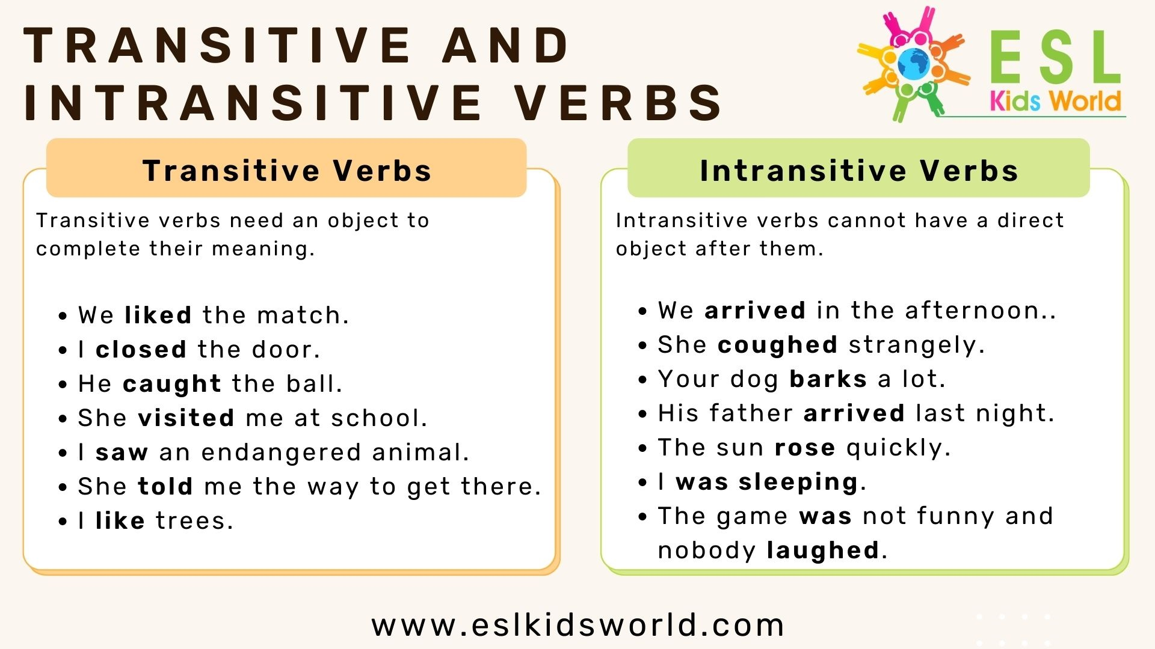
Transitive and Intransitive Verbs

Slide 5
Examples of Dual Nature Verbs
Burn
Break
Empty
Increase
Open
Spoil
Shut
TASK : Use these verbs to make a meaningful sentence

Slide 6
Objects Omitted, Meaning Retained in
Transitive Verbs
Examples:
"He has smoked (cigarettes) since he was 10."
"She plays (the saxophone) beautifully."
Highlighted verbs:
answer, ask, cook, dance, drink, eat, fail, phone, read, sing, wash, win, write

Slide 7
Adding Completions for Context Clarity
Examples:
"He paused for a few moments." (Completion not needed)
"The disease originated in Britain." (Completion needed)
Highlighted verbs:
alternate between, aspire to, care for, culminate in, object to

Slide 8
Intransitive Verbs with Completions
Examples:
"I'm sure that blue car belongs to Matthew."
"We had to contend with hundreds of complaints." (Not "We had to contend.")
Highlighted verbs:
belong to,
aspire to,
care for, culminate in, object to

Slide 9

Understanding Object Placement with Infinitives

Slide 10
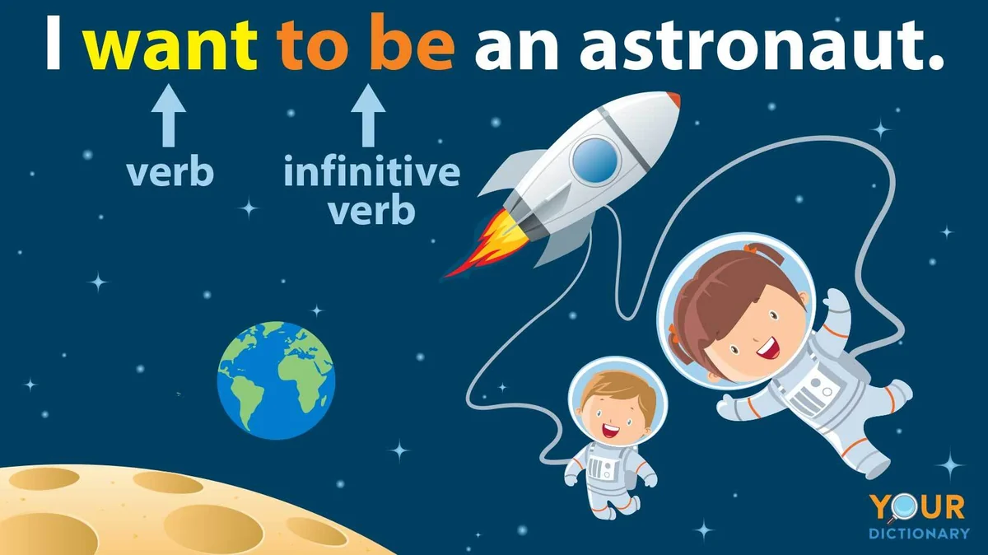

Slide 11



Verbs Requiring Object + to-infinitive
Verbs Without Object + to-infinitive
Allow, believe, cause, command, enable, encourage, entitle, force, invite, order, persuade, show, teach, tell
Agree, consent, decide, fail, hope, pretend, start, volunteer
Verbs where an object might or might not be included before a to-infinitive
Prefer, can bear, hate, help, like, love, want, wish

Slide 12
Special Cases with "for"
Verbs requiring "for" immediately after the verb
Examples:
"We waited for the taxi to come before saying goodbye."
"They arranged for Jane to stay in London."
Waited for, arranged for, appeal, apply, campaign, long (= want), plan

Slide 13
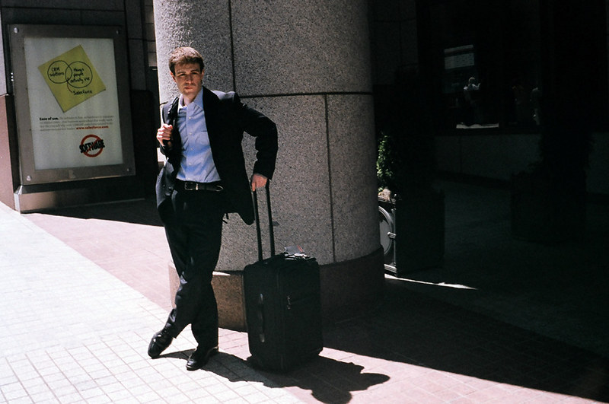
Verb + Object + Bare Infinitive
"I made Peter wait outside."
Notice, feel, hear, made, wait, observe, see,
overhear, watch; have, let

Slide 14
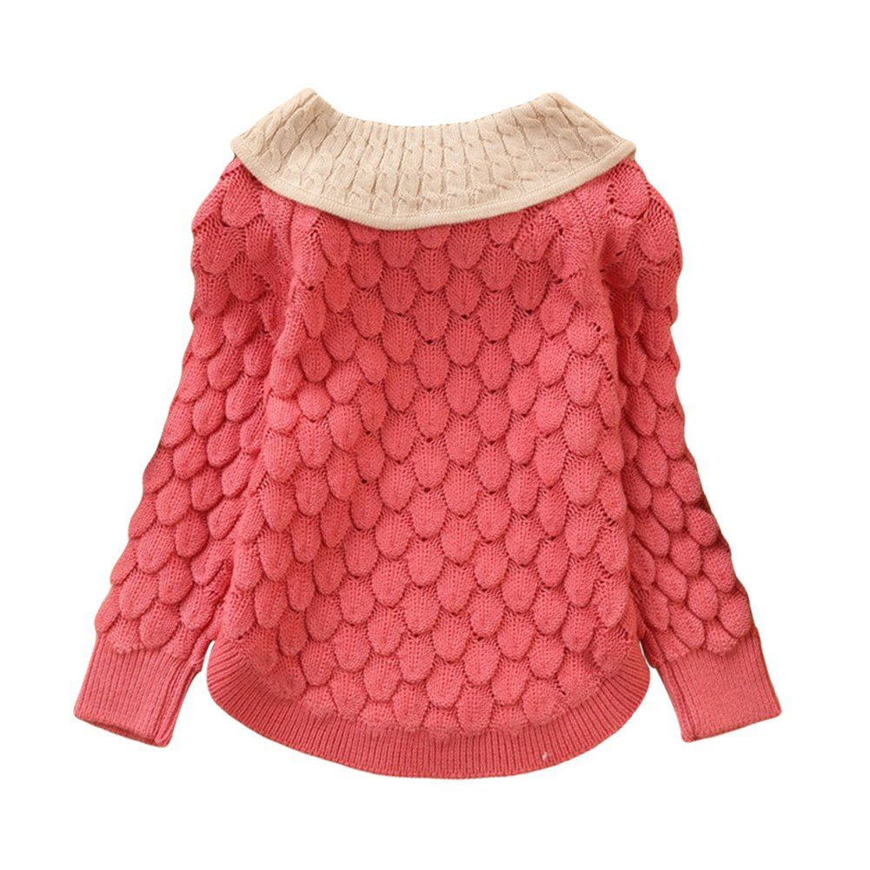
Verb + two objects
My mother bought me a new sweater .
OR
My mother bought a new sweater for me.

Slide 15
For + object
To + object
book, build, buy, catch, choose, cook, fetch, find, make,
order, pour, save
award, give, hand, lend, offer, owe,
pass, show, teach, tell, throw

Slide 16
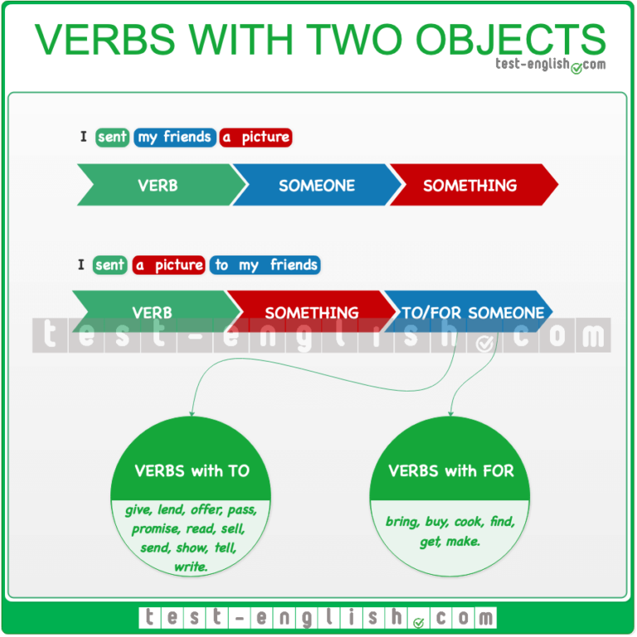
In passive sentences with certain verbs, a to-infinitive is used
Example: "He was overheard to say that he hoped John would resign."
Idiomatic Phrases
verbs with idiomatic phrases using bare infinitives
Hear tell, make believe, let (it) slip, make do, let go

Slide 17
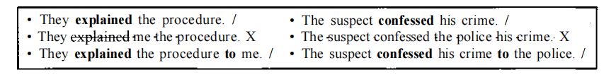
Some verbs can only have a second object if this is a prepositional object with to
Other verbs like this include
announce, demonstrate, describe, introduce, mention, point out, prove, report, say, suggest.

Slide 18
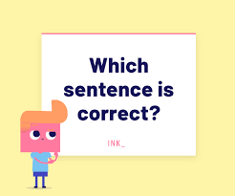
She admitted me her mistake.
She admitted her mistake to me .

Slide 19
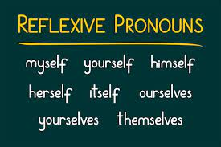

Slide 20
Uses of Reflexive Pronoun | Example
After an intransitive verb to emphasize the subject. | We phoned the plumber, and he came himself.
After the subject or object (when the verb is transitive) to add emphasis. | "I hope you like the ice cream - I made it myself."
After the verb (intransitive) to emphasize that something is done without help | "I was given this book by the author herself."
To emphasis on the Doer of an Action | He got arrested" vs. "He got himself arrested.
Reflexive pronouns can have a meaning similar to 'also.' | "John said he was feeling ill. I was feeling pretty bad myself.

Slide 21
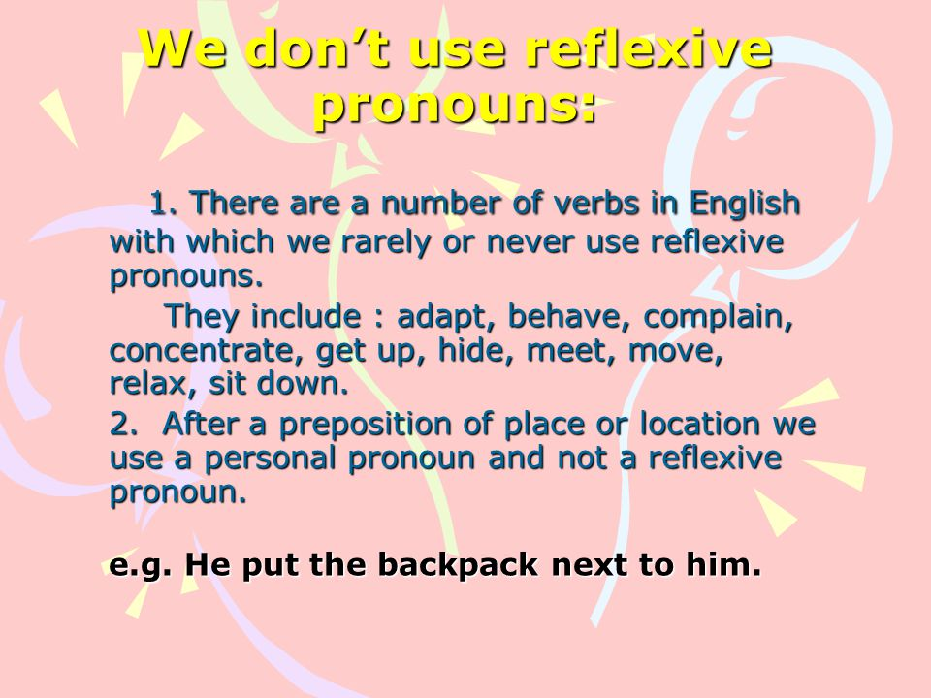
In passive sentences with certain verbs, a to-infinitive is used
Example: "He was overheard to say that he hoped John would resign."
Idiomatic Phrases
verbs with idiomatic phrases using bare infinitives
Hear tell, make believe, let (it) slip, make do, let go

Slide 22
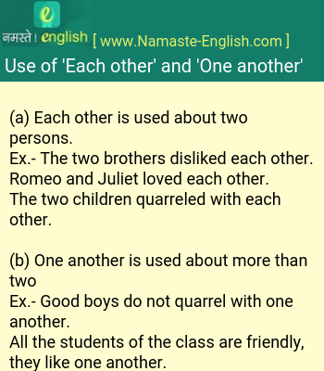
Each other
One another

Slide 23
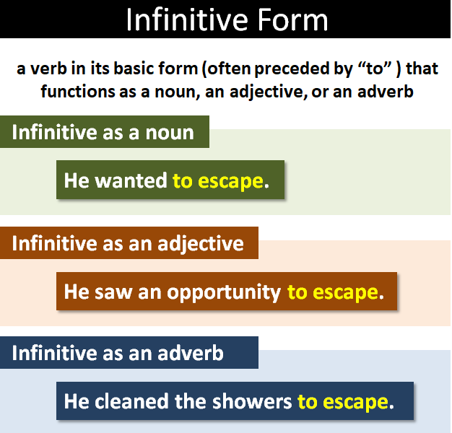

Slide 24
We can sometimes use to instead of a clause beginning with a to-infinitive when it is clear from the context what we are talking about
e.g.
• I wanted to come with you, but I won't be able to. (instead of ...to come with you.)
• 'I can't lend you any more money.' 'I'm not asking you to.' (instead of ...to lend me more money.)

Slide 25
When can we leave out to-infinitive
1. After certain adjectives and nouns:
e.g. Could you and Tom help me move house?' 'Well, I'm willing (to), and I'll ask Tom.'
2. With the verbs agree, ask, expect, forget, promise,
refuse, try, wish, want , would like
e.g. You were supposed to buy some sugar.' 'Sorry, I forgot (to).'
Call me Fred if you want (to)

Slide 26
EXCEPTIONS
We include to with negative forms of want, would like, and like, including in if-clauses and wh-clauses:
e.g.
• 'Shall we go and visit Joan?' 'I don't really want to.'
• I should have phoned Jo last night, but it was so late when I got home I didn't like to.
• 'He won't mind you phoning him at home.' 'Oh, no, I wouldn't like to.'

Slide 27


Slide 28
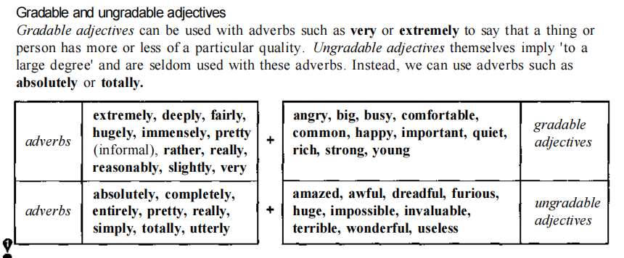
We use will (or another auxiliary), not going to, when we describe a future event that follows another.
e.g. If you move to your left, you'll (or may) be able to see the church.

Slide 29
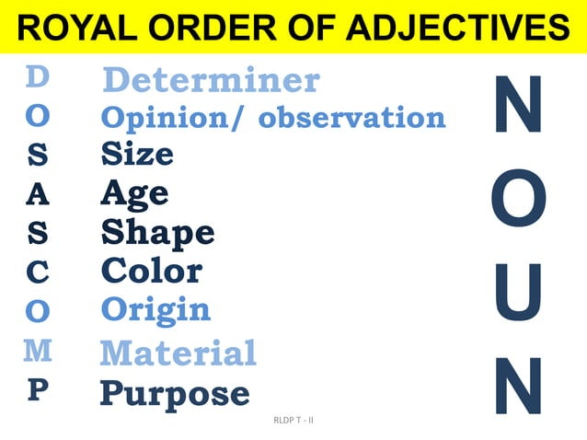
Position of adjectives

Slide 30
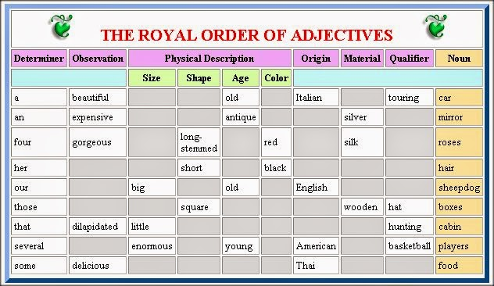

Slide 31
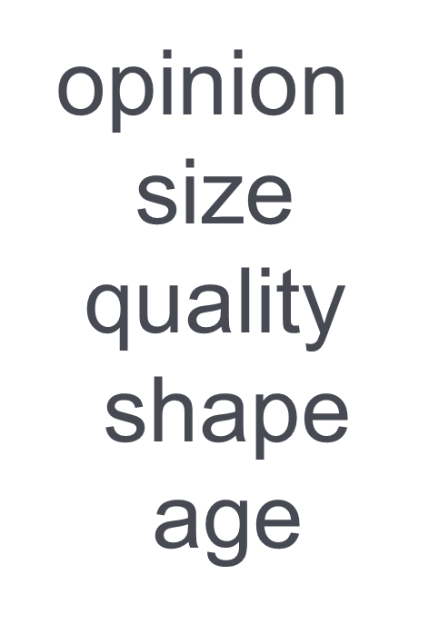

gradable adjectives
ungradable adjectives

Slide 32
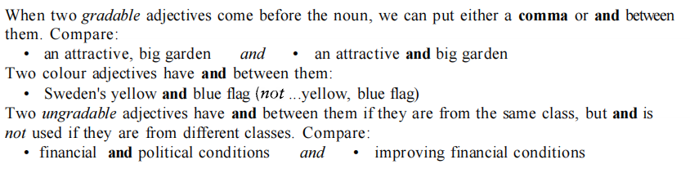
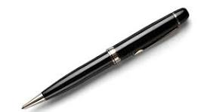

Slide 33
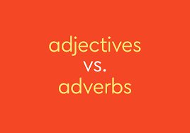

Slide 34
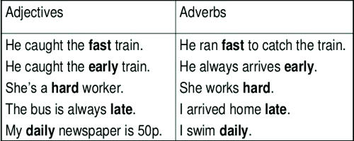

Slide 35
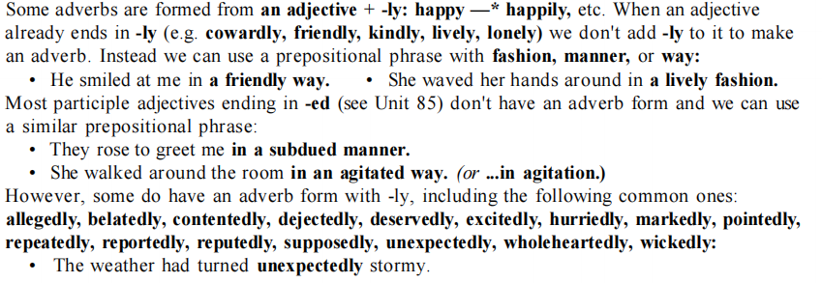

Slide 36
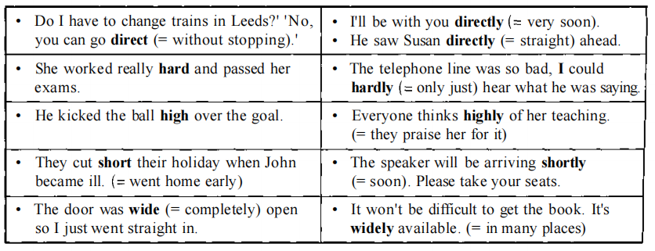
ADVERBS WITH “LY” AND WITHOUT “LY”
We use will (or another auxiliary), not going to, when we describe a future event that follows another.
e.g. If you move to your left, you'll (or may) be able to see the church.

Slide 37
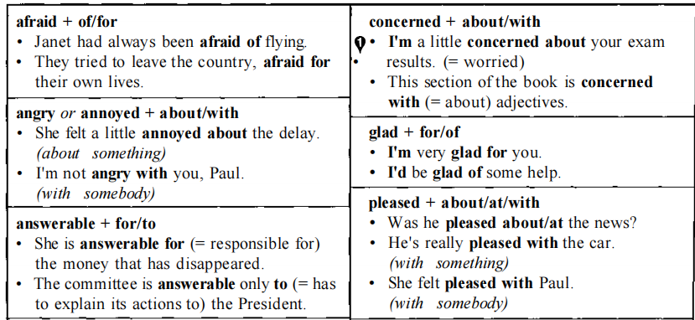
Preposition s after adjectives : afraid of/for etc .
We use will (or another auxiliary), not going to, when we describe a future event that follows another.
e.g. If you move to your left, you'll (or may) be able to see the church.

Slide 38
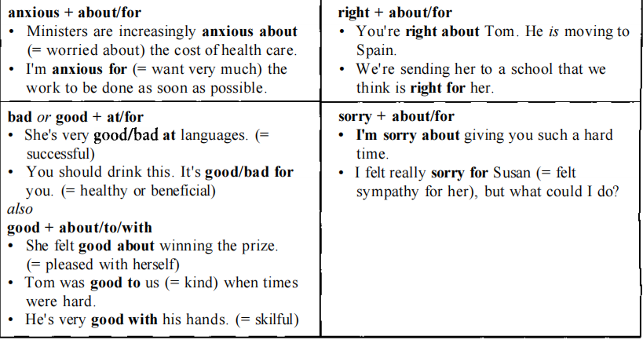
Preposition s after adjectives : afraid of/for etc .
We use will (or another auxiliary), not going to, when we describe a future event that follows another.
e.g. If you move to your left, you'll (or may) be able to see the church.

Slide 39
When a verb follows an adjective + preposition,
it takes an -ing form
e.g.
• I don't agree with smacking children if they do something wrong.
• He was famous for holding the world land speed record

Slide 40
THANK YOU

